Slide 1
Joint Meeting ASMPT – TU/e
Goal of this meeting
  Where are we now
  Where to go from here

Slide 2
Joint Meeting ASMPT – TU/e
Agenda
  What is the end goal / deliverable
  How is this formulated in measurable metrics
    Research question + aspects
  Planning
    Where are we currently standing
    What still needs to be achieved
  Discussion gantry data and experiments
  Next meeting

Slide 3
Final product
What components is the final product made up off:
  Parameter recovery
  Augmentation
  Joint estimation
    Orthogonal regularization
Next slides step by step
Two phases
  Simulation and real gantry data

Slide 4
Parameter recovery
Baseline model
  Want to be able to recover / re-estimate the parameters of the baseline model

Slide 5
Augmentation
Keep the baseline model parameters constant
  Want the augmentation to explain the mismatch between the baseline model and the data

Slide 6
Parameter recovery
Augmentation
Joint estimation
Parameter recovery + augmentation

Slide 7
Parameter recovery
Orthogonal regularization
Augmentation
Constrain augmentation output, preserve physical parameters
Joint estimation

Slide 8
Research question and aspects
For the dual-gantry system, how should physics-based plant models be augmented to improve parameter interpretability and settling prediction accuracy, particularly of cross-coupling and position-dependent dynamics?

Slide 9
Research question and aspects
For the dual-gantry system, how should physics-based plant models be augmented to improve parameter interpretability and settling prediction accuracy, particularly of cross-coupling and position-dependent dynamics?
Note: for model accuracy in simulation currently shifted away from settling specifically.
  Shifted to more general approach: mismatch between model and the entire trajectory data

Slide 10
Aspects
Position-dependent baseline modeling
Augmentation structure
Interpretability preservation
Model generalization

Slide 11
Aspects
Position-dependent baseline modeling
  In what form should the baseline model be represented for subsequent augmentation, and does position-dependent (LPV) formulation improve prediction compared to position-independent (LTI) alternatives?
Augmentation structure
  What augmentation structure can effectively capture dynamics not modeled in the physics-based baseline model, in particular flexible cross-coupling dynamics?
Interpretability preservation
  How can parameter interpretability be maintained during data-driven augmentation, compared to unconstrained approaches? Here, interpretability means that the physical parameters of the baseline retain values close to their physically meaningful initialization after augmentation.
Model generalization
  How well does the augmented model generalize to (i) held-out operating points representative of actual industrial operating conditions and (ii) unseen motion profiles relevant to the industrial use context, and how does its prediction accuracy compare to a black-box state-space model trained on the same data?

Slide 12
Aspects
Position-dependent baseline modeling
  In what form should the baseline model be represented for subsequent augmentation, and does position-dependent (LPV) formulation improve prediction compared to position-independent (LTI) alternatives?
  Baseline model in simulation: LPV outperforms LTI
Augmentation structure
  What augmentation structure can effectively capture dynamics not modeled in the physics-based baseline model, in particular flexible cross-coupling dynamics?
  Currently working on adapting Jan’s framework for the gantry setup for augmentation in simulation
    Dynamic parallel
Interpretability preservation
  How can parameter interpretability be maintained during data-driven augmentation, compared to unconstrained approaches? Here, interpretability means that the physical parameters of the baseline retain values close to their physically meaningful initialization after augmentation.
Model generalization
  How well does the augmented model generalize to (i) held-out operating points representative of actual industrial operating conditions and (ii) unseen motion profiles relevant to the industrial use context, and how does its prediction accuracy compare to a black-box state-space model trained on the same data?

Slide 13
Current status
Parameter recovery
Orthogonal regularization
Augmentation
Parameter recovery is done
Currently working on augmentation
Joint estimation

Slide 14
Current status
Parameter recovery
Orthogonal regularization
Augmentation
Parameter recovery is done
Currently working on augmentation
  Encoder
  LPV is implemented
  Data from system with MSD
Joint estimation

Slide 15
Planning
Where we currently stand
What still needs to be achieved

Slide 16
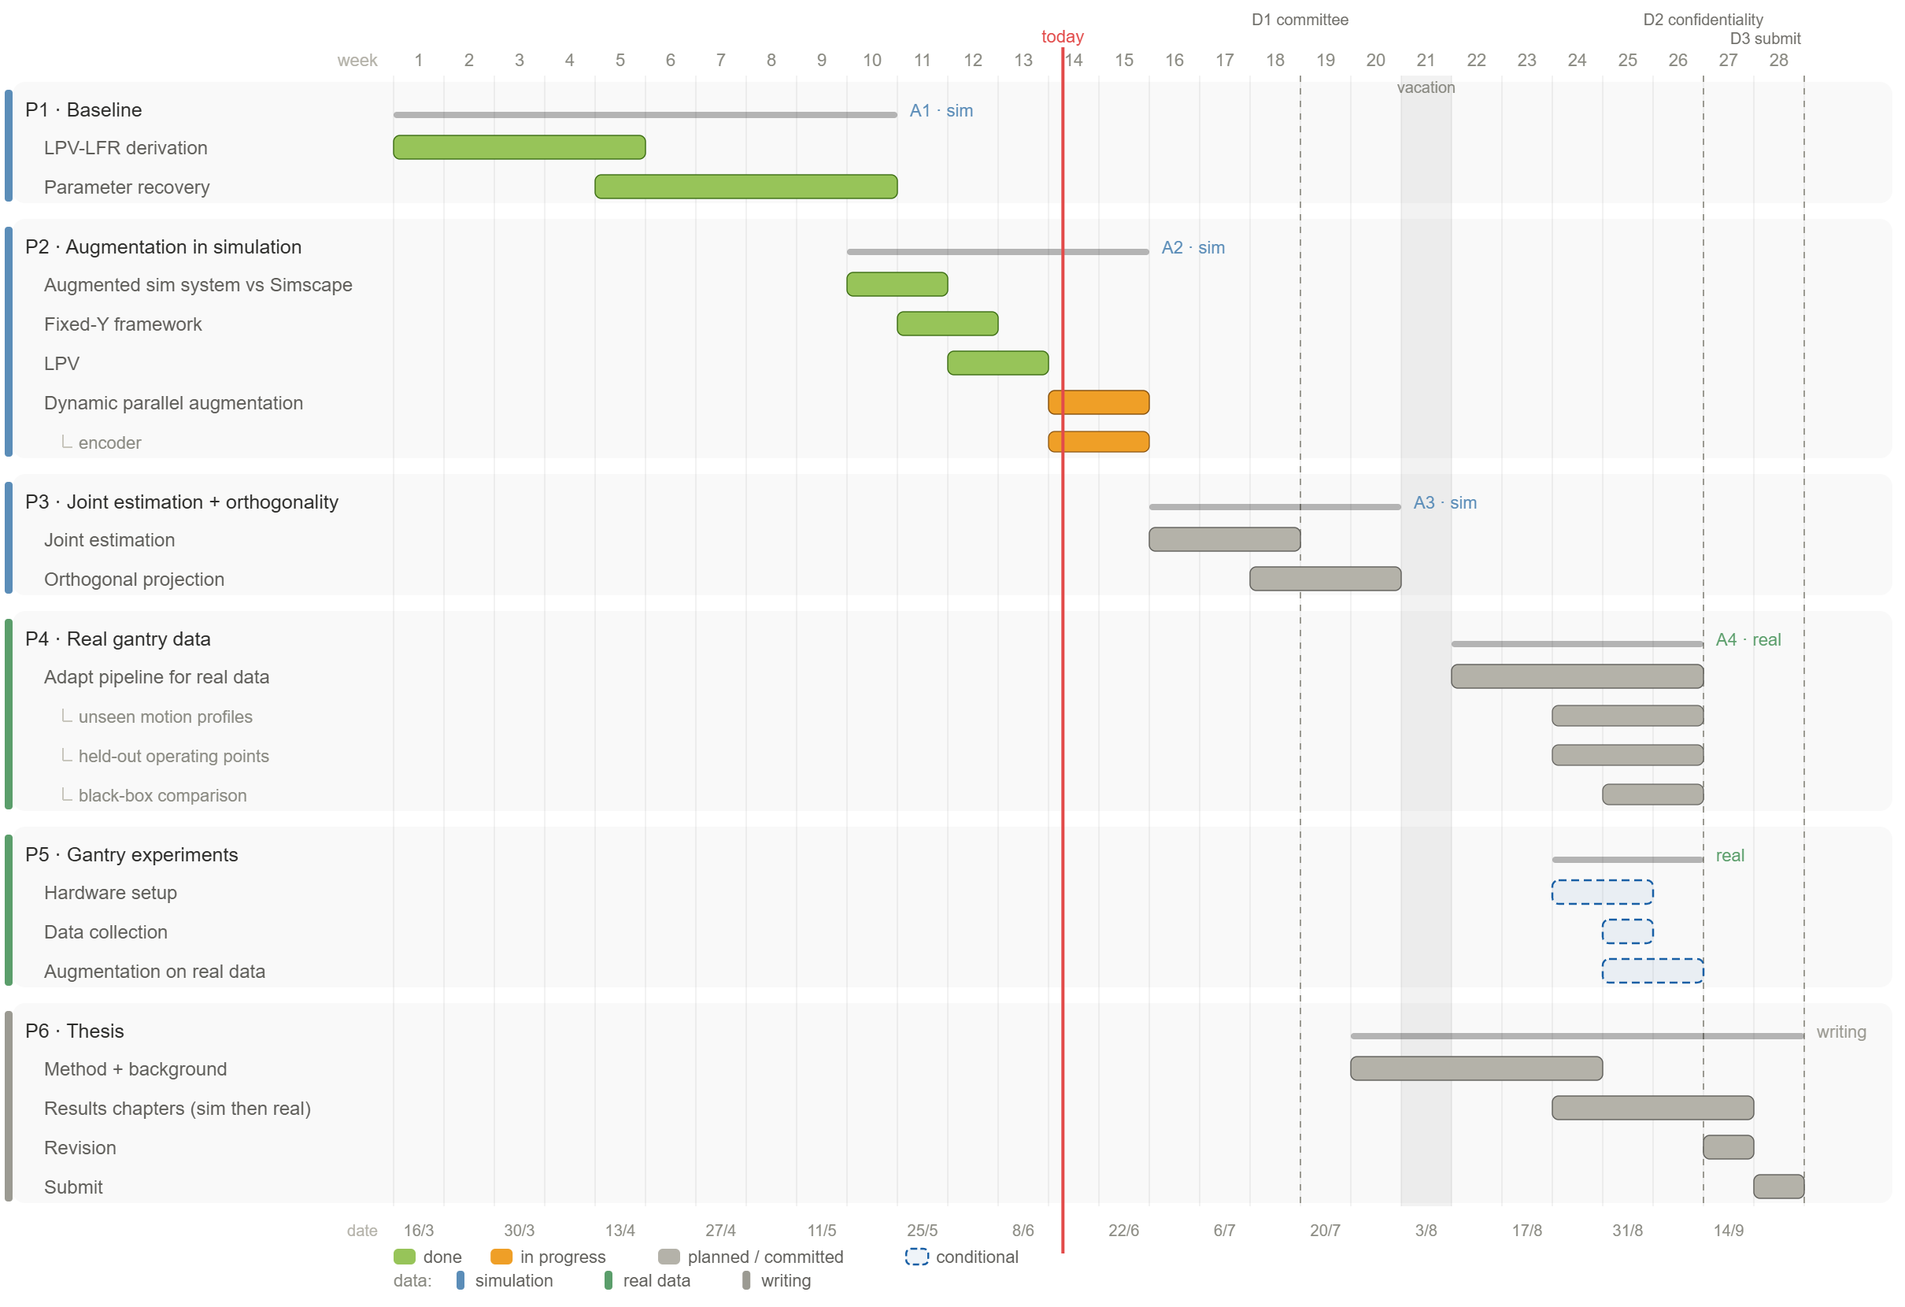

Slide 17
Results of what currently works??

Slide 18
Gantry system data & experiments
Currently available data from Telica gantry system
  Data obtained for ILC: repetitive motions and less generalizable
    Possible not enough excitation
  Kamtin system will probably not arrive
    Possibly Telica will be shipped back?
Most likely limited to the current ILC data.
Depending on if and when a gantry system will arrive, considering asking for extension

Slide 19
Next joint meeting
6 weeks from now
  27 July - 2 August

Slide 20
Meeting TU/e
Next week

